Slide 1
ITEC 1150 Ch 1.2 Lab Projects
Formatting, Input & More on DATA Types

Slide 2
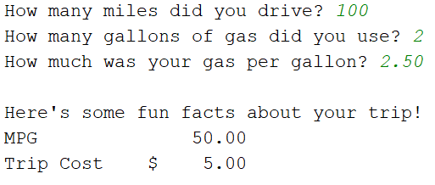
Ch 1.2 Lab Assignments
Gas Calculator PDP & program.
Create a file called PDP-gas-calc.docx. Use Program Development Plan template from D2L , Materials, Content, Resources, Grading_PDPtemplate.
The PDP will cover a program called gas_calc.py, which asks the user 1) the number of miles they drove on a trip, 2) the number of gallons of gas they used, and 3) the price of gas per gallon. The program uses their input to figure out and display the cost of the trip & the miles per gallon (MPG) for the trip. See output format below.
Ongoing challenges: what goes into the .py file comments, and what goes into your PDP document? Double check all standard requirements for the PDP & .py file.
When output is shown, it's just an example – your program must work with different inputs!

Slide 3
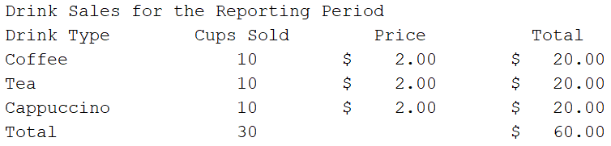
Lab Assignments, cont.
Note: you should use the PDP thought process for each program, but don’t have to turn in one for grading. FOR ALL .py PROGRAMS: include """docstring""" at top and # short comments throughout, plus user-friendly input prompts and printouts.
coffee_sales.py: We started this program during the lesson. But now, assume that your coffee shop sells coffee, tea, and cappuccino. NOTE: part of your lesson code can be used as a model for the parts you need to add!
Expand the program by asking the user for the number of cups of each drink sold, and how much each drink costs (6 separate questions).
Display the total sales for each drink, and the total sales for everything.
Print the information into a nice looking table using python 3 formatting (adapt the code from bus_fare2.py, done in class).

Slide 4
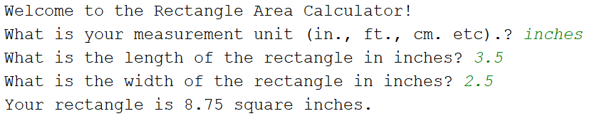
Lab Assignments, cont.
area.py : The area of a rectangle is calculated by taking its length times its width. Write a program which asks the user for 1) their measurement unit, 2) the length of a rectangle, and 3) the width of a rectangle. The program will calculate the area and display the answer within a sentence, including the units that they are using. Important: Use a rounding and a format code, to cut off possible long decimals at 2 places. Test the program to ensure it works with different units, lengths and widths.
NOTE: the values in italics at the end of lines 2-4 are NOT hard coded. They are user input & could be different. Likewise, in the 3 print statements, the word "inches" and the number 8.75 are NOT hard coded. They are filled in from variable names & will change depending on user input.

Slide 5
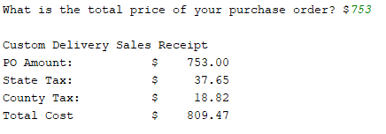
Lab Assignments, cont.
sales_tax.py: Write a program that asks the user to enter the price of a purchase order. Then, the program figures state sales tax at 5% and county sales tax at 2.5%. The output should include Purchase Order Price, State Tax, County Tax, and Grand Total.
Challenge: to avoid the appearance of math errors, it's best to use the round() function on the tax calculations – round each to 2 decimal places.
When printing, use the .format() and/or f-string shortcut method to create a table as shown below. Test with sample data and other values to ensure it's a dynamic solution.
This table adapts the formatting model shown on the lesson slide 14

Slide 6
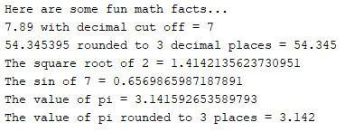
Lab Assignments, cont.
Math-1.py : Try out some math functions. You may need to use online help for this.
Important: Add this import statement immediately after your """docstring"""
import math
Paste these comments into your python file, as a heading for each task. Then write a line of code below each comment, to provide the result as shown.
# cut off 7.89 to 7
# round 54.345395 to 54.345
# calculate the square root of 2
# calculate the sin of 7
# display the value of pi
# display pi rounded to 3 decimal places

Slide 7
Upload!
In all files, don't forget your comments ("""docstring""" and # short), naming conventions and python 3 formatting style
Lab projects to upload to the drop box:
gas_calc.py
coffee_sales.py
area.py
sales_tax.py
math-1.py
Questions? Let me know – before the deadline!

